Slide 1
Epistasis
Epistasis occurs when the effect of one gene (dominant) or gene pair (recessive) masks the effect of another gene or gene pair.
Can be either dominant or recessive
Mutation 1 x Mutation 2
Double mutants
Phenotype A Phenotype B
Phenotypes A + B
Mutation 3 x Mutation 4
Double mutants
Phenotype C Phenotype D
Phenotype C
(3 is epistatic to 4)

Slide 2
Recessive epistasis
Example: coat color of Labrador retrievers
ee is epistatic to BB or Bb
One locus determines the type of pigment produced by the skin cells:
B = black pigment
b = brown pigment.
Second locus affects the deposition of the pigment in the hair shaft
E = allows pigment deposition
e = prevents pigment deposition

Slide 3
Effect on Mendelian ratio
Recessive epistasis
If a true-breeding black Labrador is crossed with a true-breeding golden Lab,
BBEE x bbee
all the F₁ progeny will be black.
BbEe
If the F₁ dogs are bred, the F₂ ratio will be:

Slide 4
The effect on Mendelian ratio
Recessive epistasis
B_E_ 9 black
bbE_ 3 brown
B_ee 3 golden
bbee 1 golden
9
3
4
The phenotype of ee (golden) masks those of BB, Bb, and bb

Slide 5
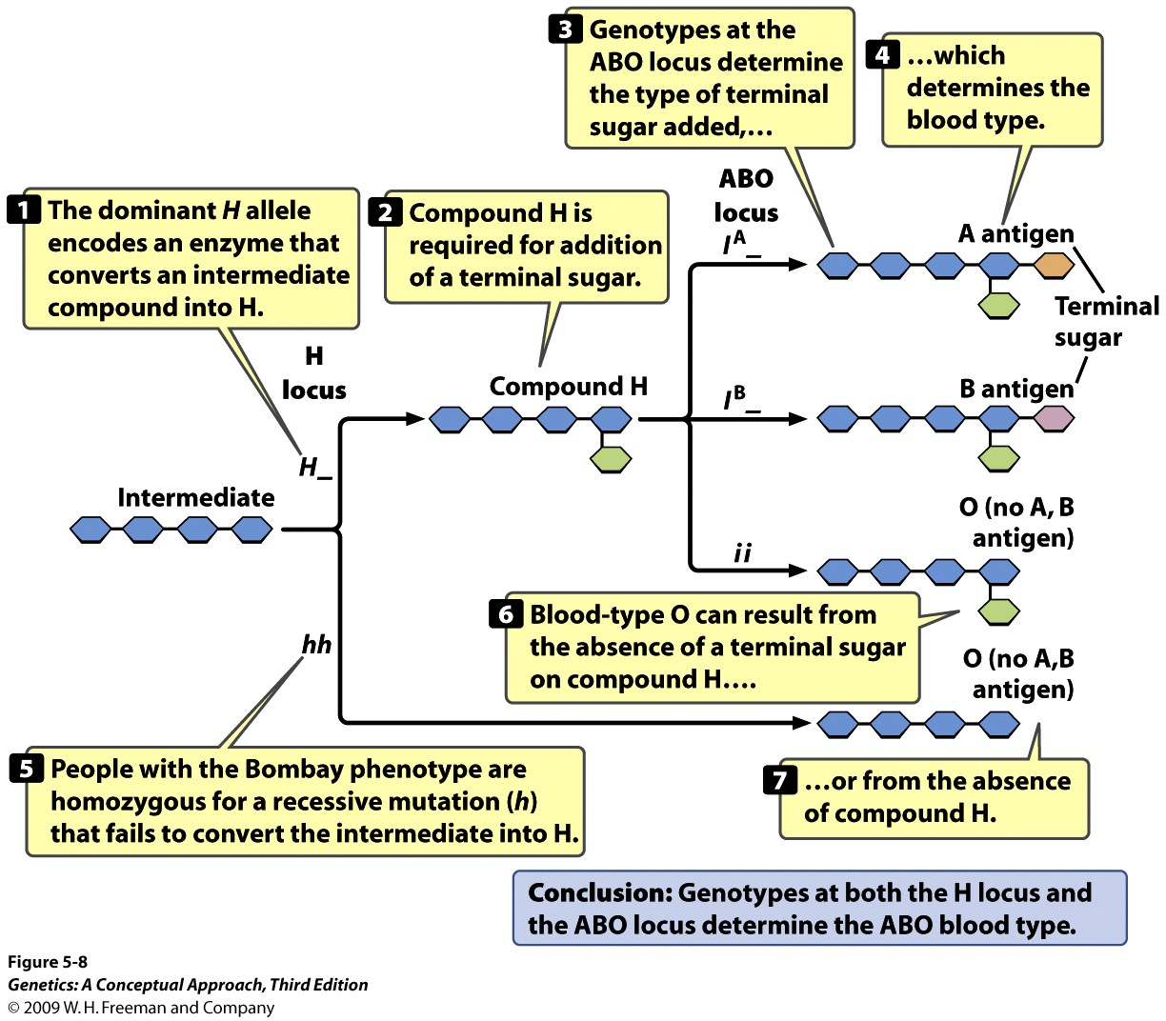
Another example of recessive epistasis: Bombay phenotype
Notes:
5.8 Expression of the ABO antigens depend on alleles at the H locus. The H locus encodes a precursor to the antigens called compound H. Alleles at the ABO locus determine which types of terminal sugars are added to compound H.

Slide 6
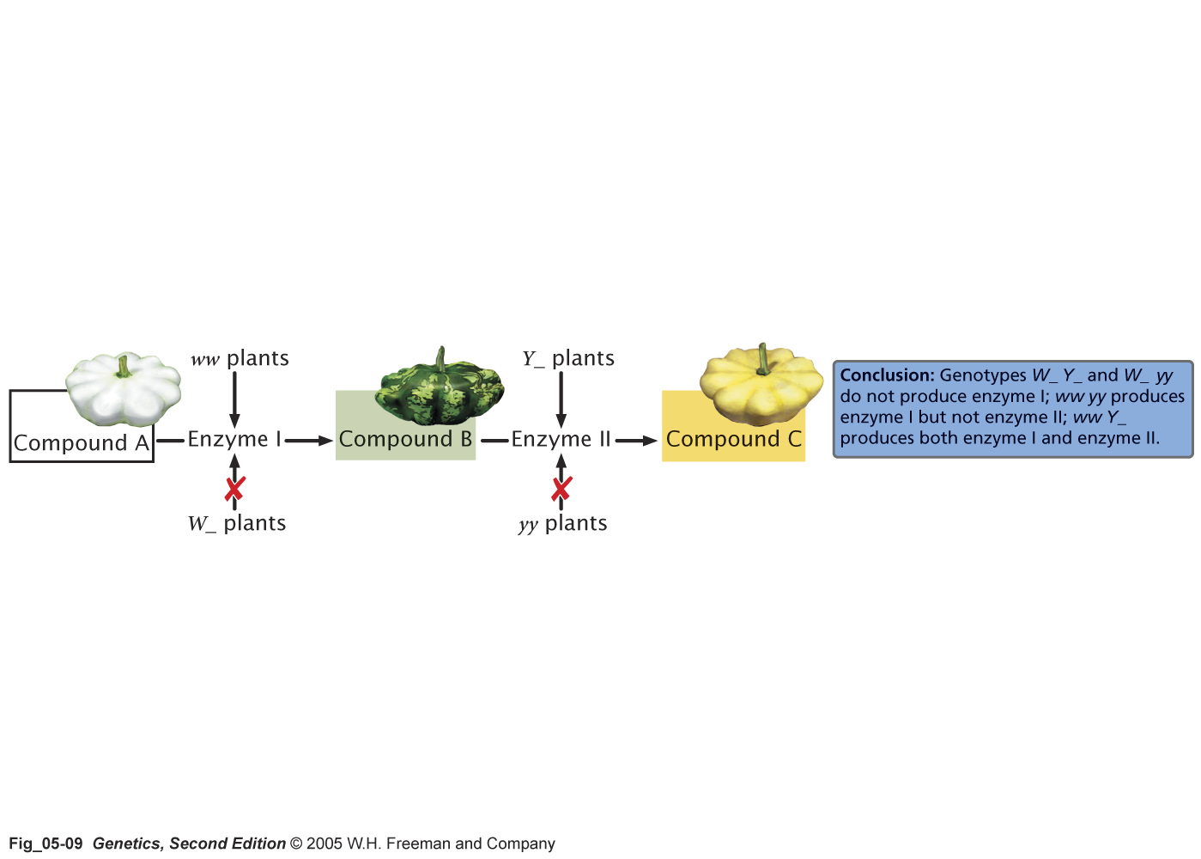
Dominant epistasis
Example: fruit color of summer squash
(yellow, white, and green)
W = inhibits the conversion of Compound A to B
w = produces enzyme I
Y = produces enzyme II
y = no enzyme II

Slide 7
Dominant epistasis
Plants with
White squash
x
Plants with
green squash
P
WWYY
wwyy
Plants with
White squash
intercross
F₁
WwYy
W_Y_ 9 (white)
W_yy 3 (white)
wwY_ 3 (yellow)
wwyy 1 (green)
12
F₂
3
1

Slide 8
Epistasis
Very useful for ordering genes along a pathway.
In a biosynthetic pathway, products of early steps in the pathway are substrates for the later steps. Therefore, the upstream gene is epistatic.
In a regulatory or switch pathway, the upstream gene product alters the activity of the downstream target. Therefore the downstream gene is epistatic.

Slide 9
Interpretation of epistasis in a biosynthetic pathway
Because W is epistatic to y,
W functions upstream of y.

Slide 10
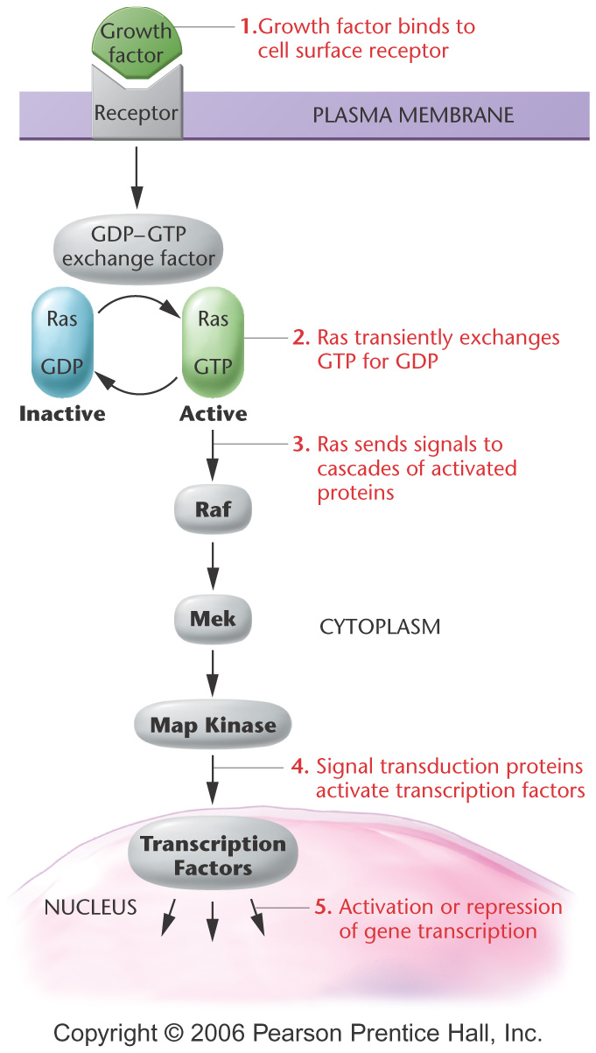
Interpretation of epistasis in a regulatory pathway
Ras is epistatic to GEF, meaning that Ras functions downstream of GEF.
Notes:
Figure 18-11 A signal transduction pathway mediated by Ras.

Slide 11
In normal cells at resting state,
GDP
GDP
Ras⁺
GDP
Ras⁺
GDP
nucleus
GDP
GDP

Slide 12
When encountered specific signals,
GDP
GDP
Ras⁺
GTP
Ras⁺
GEF
GEF⁻
GTP
GEF⁻
GDP
GDP

Slide 13
However, if GEF is mutated, Ras will remain GDP-bound.
GDP
GDP
Ras⁺
GDP
Ras⁺
GEF
GEF⁻
GDP
GEF⁻
GDP
GDP

Slide 14
In cells carrying a dominant-active Ras allele,
GTP
GTP
Ras^{V12}
GTP
Ras⁺
GEF⁺
GDP
GEF⁺
GDP
GDP

Slide 15
Some Ras will be GTP-bound even if GEF is mutated.
GTP
GTP
Ras^{V12}
GTP
Ras⁺
GEF
GEF⁻
GDP
GEF⁻
GDP
GDP

Slide 16
Sex-influenced and sex-limited
sex-influenced characteristics are determined by autosomal genes and are inherited according to Mendel’s principles, but they are expressed differently in males and females (different penetrance).
Sex-limited characteristics are expressed in only one sex (zero penentrance in the other sex)

Slide 17
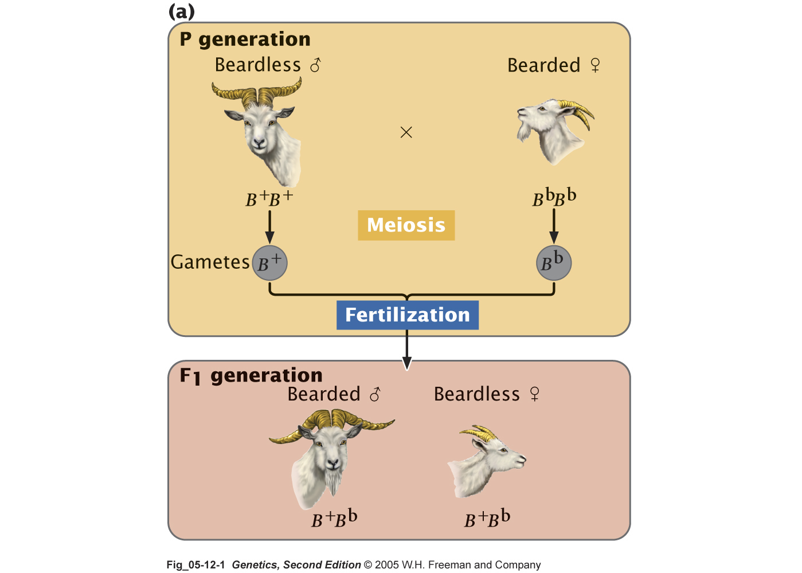
Sex-influenced characteristic
Example: the presence of a beard on some goats.
B^{b} = autosomal gene, dominant in males but recessive in females

Slide 18
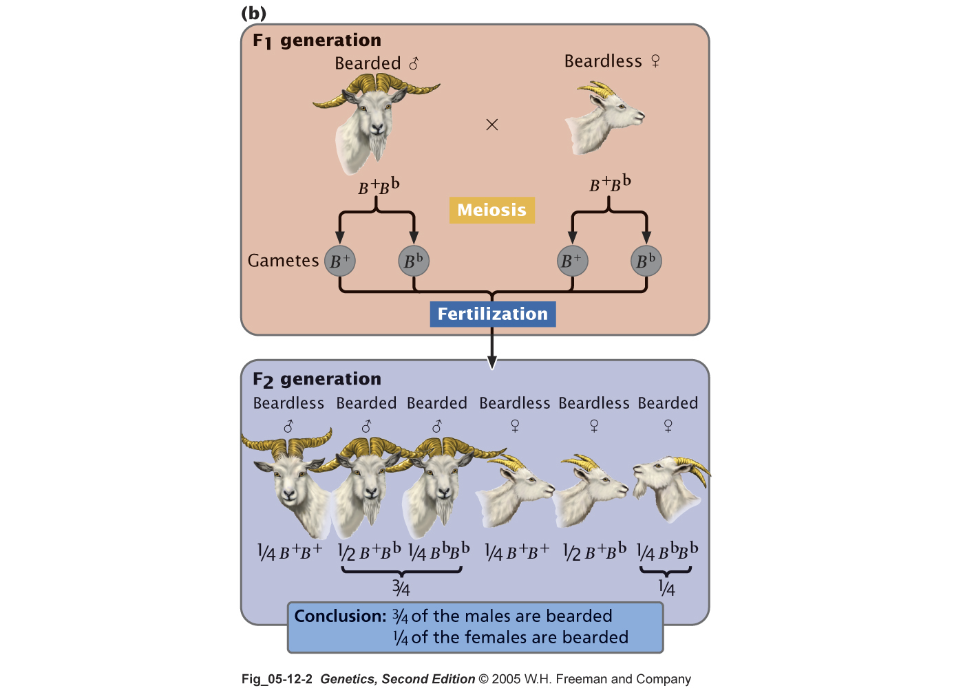

Slide 19
Sex-influenced characteristic
Example: pattern baldness (hair loss from the front and the top of the head)
-Autosomal, not from the mother side of the family (x-linked)
-Dominant in males, recessive in females
-Enhanced by the presence of male sex hormones; males who are castrated at an early age rarely become bald.

Slide 20
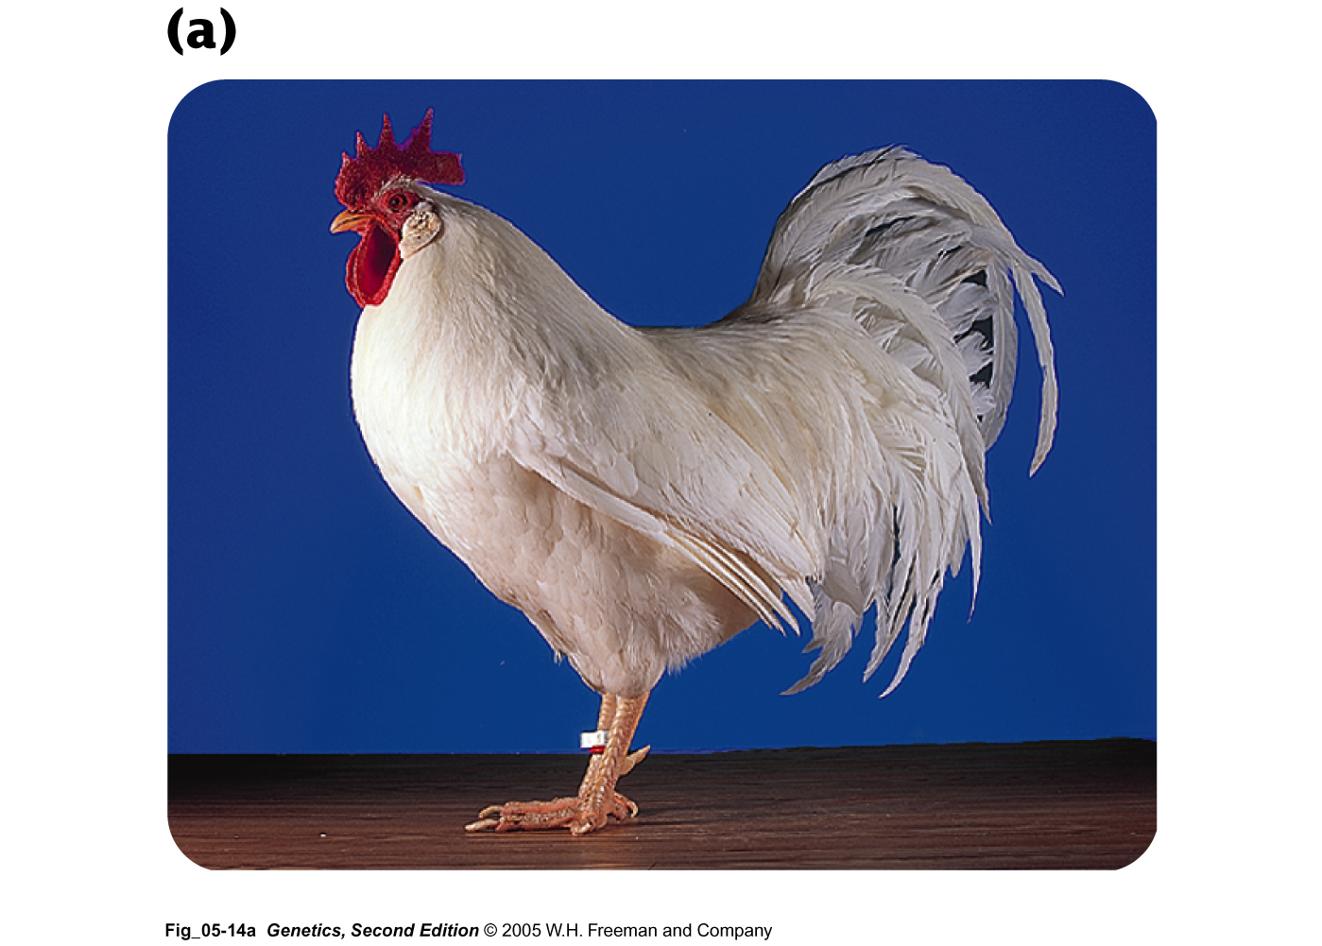
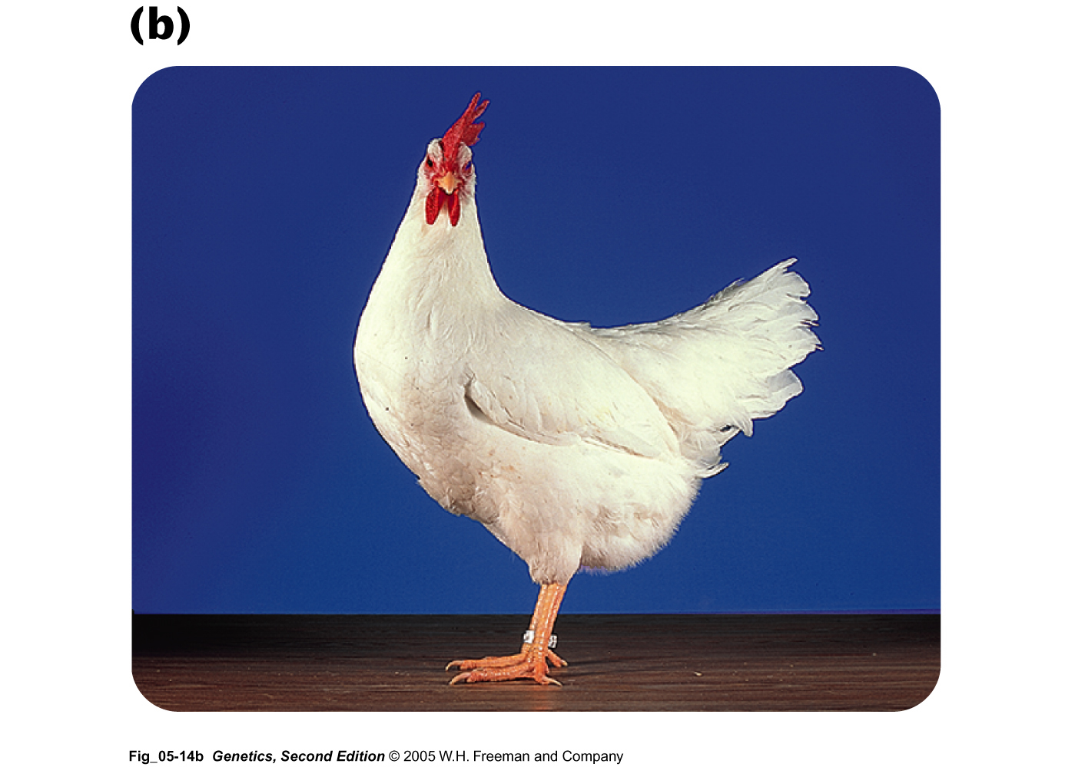
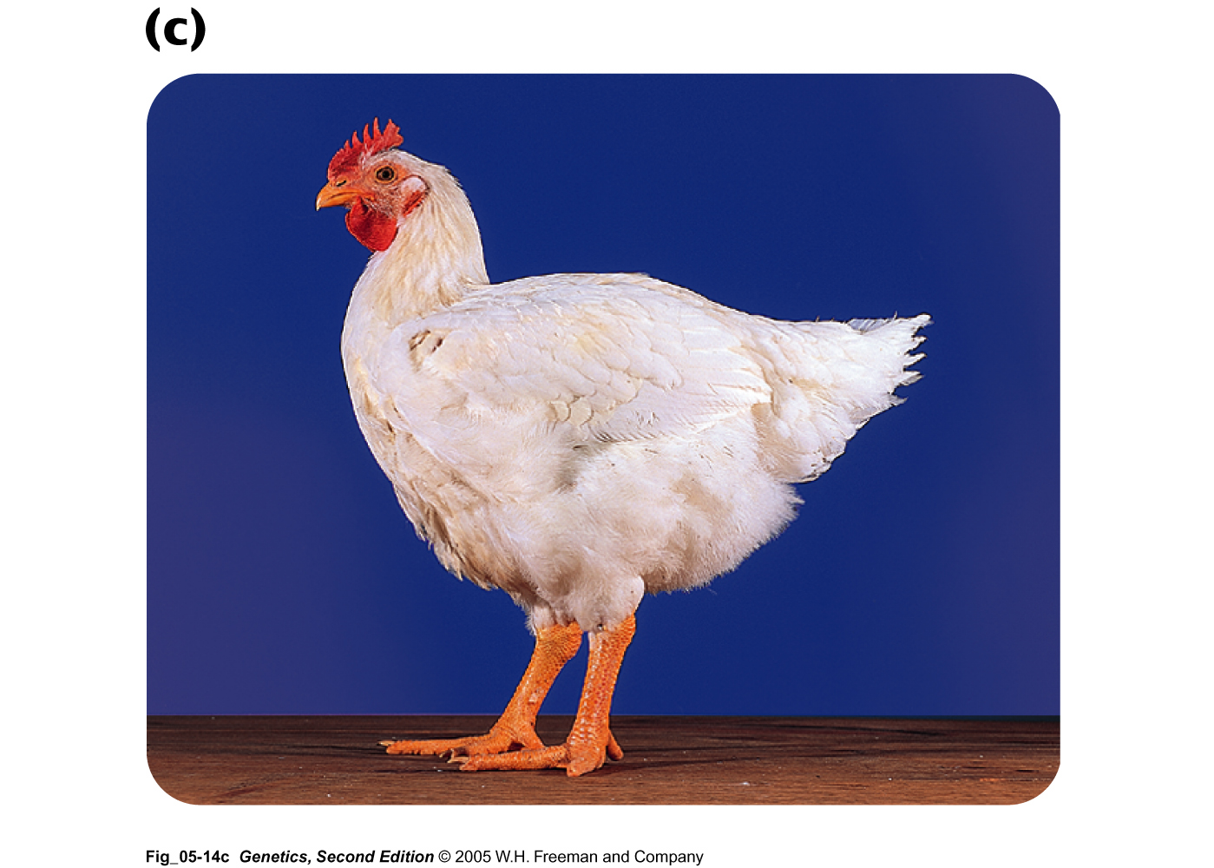
Sex-limited characteristic
Example: Chicken plumage pattern
Genotype Male phenotype Female phenotype
HH hen feathering hen feathering
Hh hen feathering hen feathering
hh cock feathering hen feathering
cock feathering
male
hen feathering
female
hen feathering
male

Slide 21
Genetic Background
In some cases, the expression of phenotypes depends on the genetic configuration.
Example: genes with redundant functions.
gene
I
A
B
gene
“Survival”
II
A
B

Slide 22
Genes with redundant function
gene
gene
I
I
A
B
A
B
gene
“Survival”
gene
“Survival”
II
II
A
B
A
B
gene
I
A
B
gene
“death”
II
A
B

Slide 23
Synthetic lethals
Two viable single mutants are intercrossed, the resulting double mutants are lethal.
Can be dominant or recessive
Usually suggests interesting interaction or functional redundancy

Slide 24
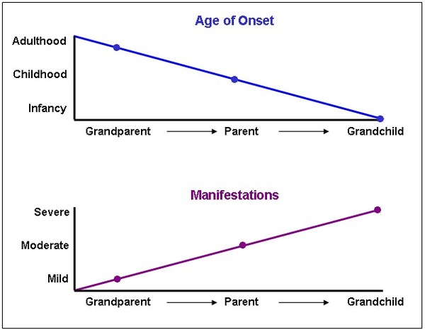
Genetic anticipation
-Heritable disorders that exhibit a progressively earlier age of onset and an increased severity of the disorder in each successive generation.
Examples: Myotonic dystrophy and Huntington.
Mechanism: poly-amino acid tract in the proteins.

Slide 25
Poly-glutamine expansion in neurodegenerative diseases
QQQQQ
QQQ-80-QQQ

